Slide 1
Learn Writing in English
Presented by:
Sohrab Hussain
Instructor (English)
Sylhet Government Technical School & College, Sylhet.

Slide 2
Jobs to learn the skill
Learning the Grammatical Rules.
Practicing the Rules
Composing the Sentences by Using the Rules

Slide 3
teaser
What we have learn
WHAT IS SUBJECT & PREDICATE?
HOW TO IDENTIFY THE SUBJECT & PREDICATE?
WHAT IS THE PHRASE & THE CLAUSE?
WHAT IS THE DIFFERENCE BETWEEN THE PHRASE & THE CLAUSE?
What we will learn
NAMES & FUNCTIONS OF THE PARTS OF SPEECH.

Slide 4
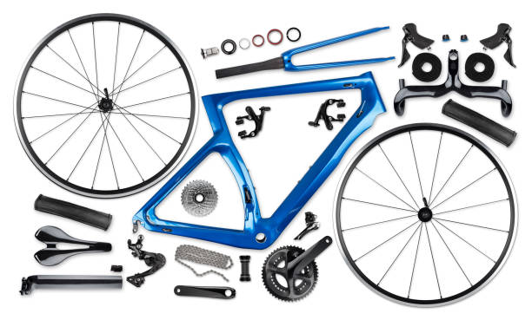
PARTS OF SPEECH
PARTS OF a Bicycle
Named after their functions they do in a sentence
You are a student
You
are
a
student

Slide 5
NAMES OF THE parts OF SPEECH
A SENTENCE CONTAINING ALL PARTS OF SPEECH

Slide 6
NOUN
PARTS OF SPEECH: NAMES & FUNCTIONS
NOUN
A WORD
USE : AS A NAME OF A THING

Slide 7
PRONOUN
PARTS OF SPEECH: NAME & FUNCTIONS
PRONOUN
A WORD
USE : INSTEAD OF A NOUN
ME: SOHRAB

Slide 8
ADJECTIVE
PARTS OF SPEECH: NAME & FUNCTIONS
ADJECTIVE
A WORD
USE : ADD SOMETHING TO THE MEANING OF THE NOUN

Slide 9
VERB
PARTS OF SPEECH: NAME & FUNCTIONS
VERB
A WORD
USE : TO EXPRESS AN ACTION OR STATE

Slide 10
ADVERB
PARTS OF SPEECH: NAME & FUNCTIONS
ADJECTIVE
ADVERB
VERB
A WORD
USE : ADD SOMETHING TO THE MEANING OF THE VERB, ADJECTIVE OR ANOTHER AVDVERB

Slide 11
PREPOSITION
PRONOUN
USE : WITH A NOUN OR PRONOUN TO SHOW THE RELATION BETWEEN NOUN & OTHER WORDS
PARTS OF SPEECH: NAME & FUNCTIONS
PREPOSITION
A WORD

Slide 12
CONJUNCTION
PARTS OF SPEECH: NAME & FUNCTIONS
USE : TO JOIN WORDS OR SENENCES
A WORD
CONJUNCTION

Slide 13
INTERJECTION
PARTS OF SPEECH: NAME & FUNCTIONS
USE : TO EXPRESS SOME SUDDEN FEELING
A WORD
INTERJECTION

Slide 14
RECap

Slide 15
NAMES OF THE parts OF SPEECH
A SENTENCE CONTAINING ALL PARTS OF SPEECH
ADJECTIVE
ADVERB
VERB
PREPOSITION
CONJUNCTION
INTERJECTION
NOUN
PRONOUN

Slide 16
Practice

Slide 17
Identify the Parts of speech
1.Still waters run deep.
2.He still lives in that house.
Adjective
Adverb
3.After the thunder comes the rain.
4.The after effects of the drugs are bad.
Preposition
Adjective

Slide 18
Identify the Parts of speech
5. It weighs about a pound.
6.He told us all about the battle.
Adverb
Preposition
7.He was only a yard off me.
8.Suddenly one of the wheels came off.
Preposition
Adverb

Slide 19
Identify the Parts of speech
9. Muslims fast in the month of Ramzan.
10.He kept the fast for a week.
Verb
Noun
11. He is on the committee.
12.Let us move on.
Preposition
Adverb

Slide 20
Identify the Parts of speech
13. Sit down and rest a while.
14. I will watch while you sleep.
Noun
Conjunction
15. They while away their savings with books and games.
Verb

Slide 21
thank you

