Slide 1
Learn Writing in English
Presented by:
Sohrab hussain
instructor (English)
Sylhet Government Technical School & College, Sylhet.

Slide 2
Jobs to learn the skill
Learning the Grammatical Rules.
Practicing the Rules
Composing the Sentences by Using the Rules

Slide 3
teaser
What we have learn
WHAT IS A SENTENCE?
WHAT ARE THE TYPES OF SENTENCE?
What we will learn
WHAT IS SUBJECT & PREDICATE?
HOW TO IDENTIFY THE SUBJECT & PREDICATE?
WHAT IS THE PHRASE & THE CLAUSE?
WHAT IS THE DIFFERENCE BETWEEN THE PHRASE & THE CLAUSE?

Slide 4
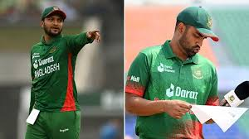
Sakib & tamim are teammates.
Name of persons
saying something about the persons
SUBJECT
PREDICATE

Slide 5
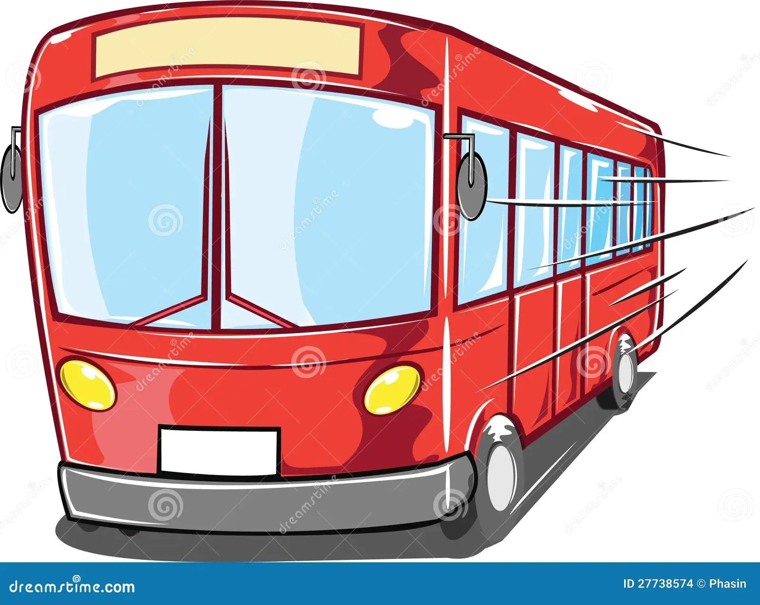
POSITIONS OF SUBJECT
Poltu is going to school.
usually comes first
But
occasionally put after the predicate
Here comes the bus.

Slide 6
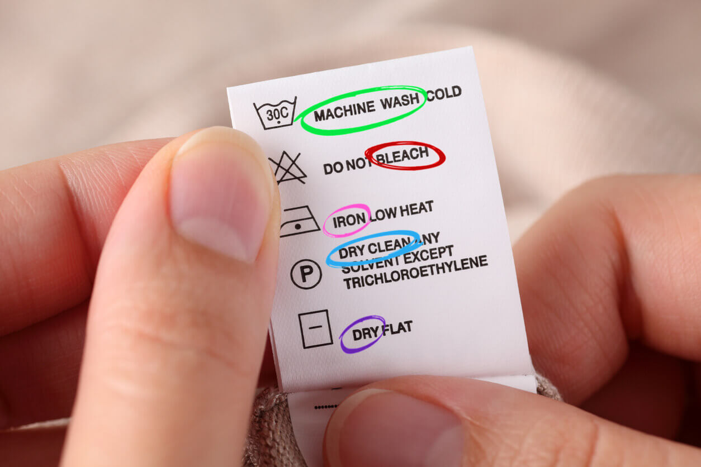
expresses a command, request, prayer, wish , etc.
imperative sentence
(You)
Do not Bleach.
subject left out

Slide 7
1. Boltu has a chain of Gold
A Phrase
A Clause
2. Boltu has a chain which is made of gold.

Slide 8
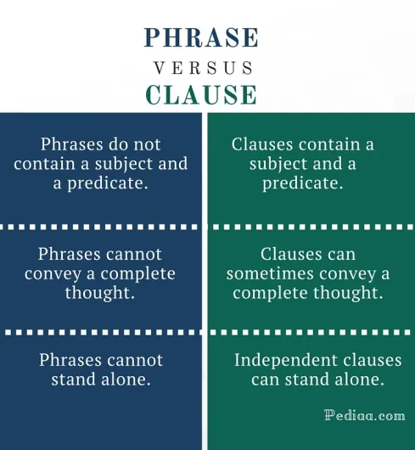
Boltu has a chain which is made of gold.
Boltu has a chain of Gold

Slide 9
Practice

Slide 11
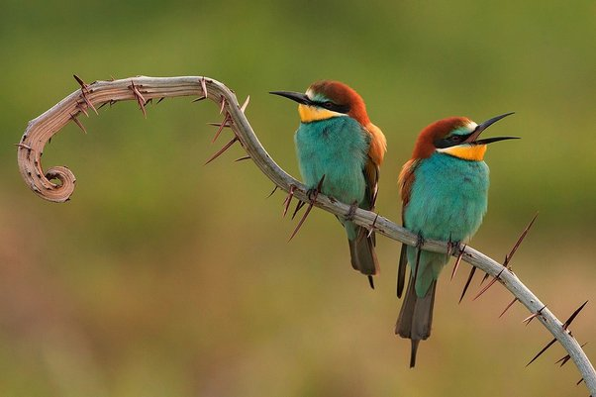
Identify the subject & Predicate
1. The singing of the birds delights us
Subject
The singing of the birds
Predicate
Delights us

Slide 12
Identify the subject & Predicate
2. bad habits grow unconsciously.
Subject
bad habits
Predicate
grow unconsciously.

Slide 13
Identify the subject & Predicate
3. we cannot pump the ocean dry.
Subject
We
Predicate
cannot pump the ocean dry.

Slide 14
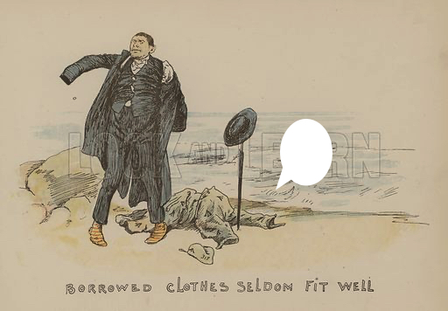
Identify the subject & Predicate
4. borrowed garments never fit well.
Subject
borrowed garments
Predicate
never fit well.

Slide 15
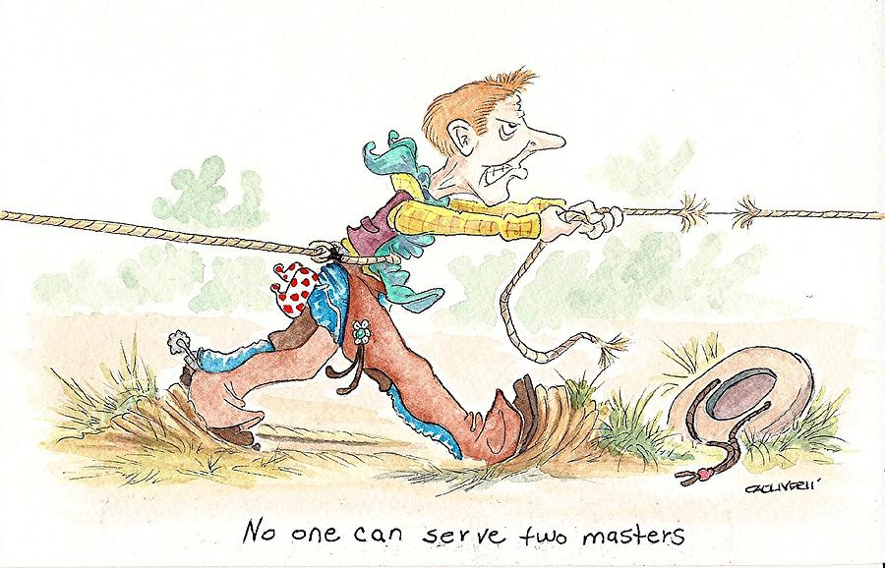
Identify the subject & Predicate
5. no one can serve two masters.
Subject
no one
Predicate
can serve two masters.

Slide 16
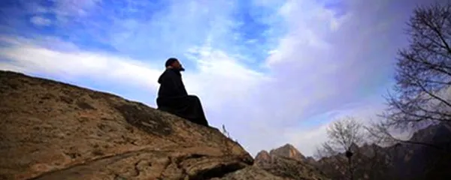
Identify the subject & Predicate
6. on the top of the hill lives a hermit.
Subject
a hermit.
Predicate
on the top of the hill lives

Slide 17
recap
We have learn:
What is a subject & predicate?
The positon of a subject.
Subject on imperative sentence.
The phrase & the clause.
Difference between the phrase & the clause?

Slide 18
thank you

