Slide 1
Learn Writing in English
Presented by:
Sohrab hussain
instructor (English)
Sylhet Government Technical School & College, Sylhet.

Slide 2
Jobs to learn the skill
Learning the grammatical Rules.
Practicing the rules
composing the sentences by using the rules

Slide 3
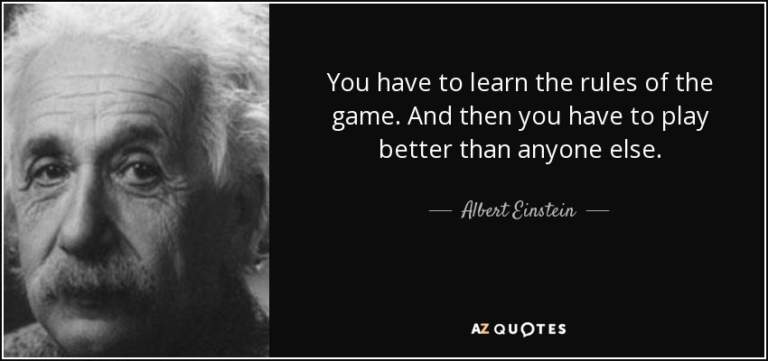

Slide 4
1. Learning the grammatical Rules
What we will learn
WHAT IS A SENTENCE?
WHAT ARE THE TYPES OF SENTENCE?

Slide 5
Language
Sentence

Slide 6
He is going to school.
Group of words
makes complete sense
Sentence

Slide 7
Kinds of Sentences
He is going to school.
makes a statement
Assertive sentence

Slide 8
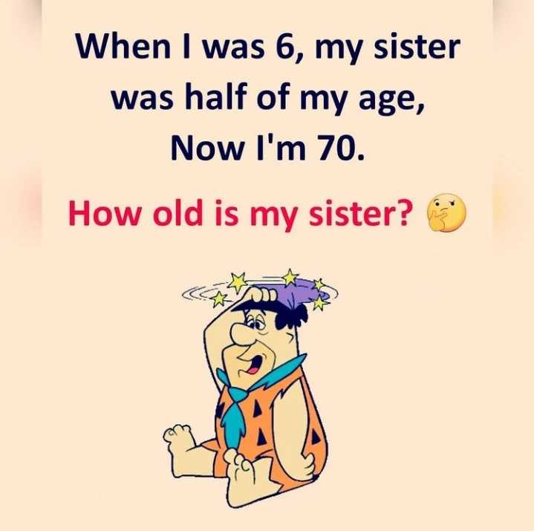
asks a question
interrogative sentence

Slide 9
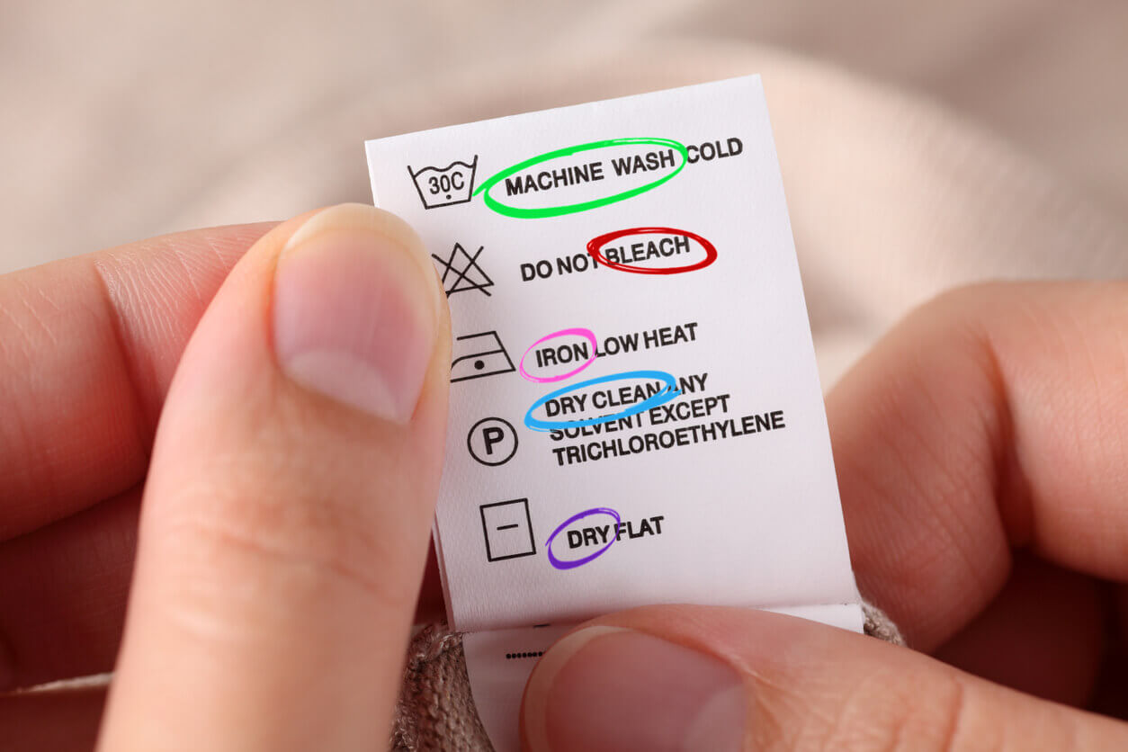
expresses a command, request, prayer, wish , etc.
imperative sentence

Slide 10
More examples of imperative sentences

Slide 11
expresses a strong feeling
exclamatory sentence

Slide 12
recap

